Slide 1
Skill of Listening, Literature and Proper Communication
Presented by
Rajeev Yadav
Assistant Professor
Department of English
Indira Gandhi Government PG College,
Bangarmau, Unnao.

Slide 2
The Art of Listening
“If we were supposed to talk more than listen, we would have been given two mouths and one ear.” Mark twain
Listening is the absorption of the meaning of words and sentences by the brain. Listening leads to the understanding of facts and ideas.

Slide 3
Listening Vs Hearing
Hearing – physical process; natural; passive
Listening – physical and mental process; active learned process; a skill.
Listening is hard!
You must choose to participate in the process of learning.

Slide 4
What is Effective Listening?
Effective listening skills are the ability to actively understand information provided by the speaker, and display interest in the topic discussed. It can also include providing the speaker with feedback, by asking pertinent questions so the speaker knows the message is received.
Effective Listening is a skill using multiple senses to comprehend the message being sent by the speaker.

Slide 5
Importance of Listening in Communication
Listening is the most powerful form of acknowledgment …a way of saying, “You are important.”
Listening builds stronger relationships …creates a desire to cooperate among people because they feel accepted and acknowledged
Listening promotes being heard …”Seek first to understand, then be understood.”
Listening creates acceptance and openness …conveys the message that “I am not judging you.”
Listening leads to learning …openness encourages personal growth and learning
Listening reduces stress and tension …minimizes confusion and misunderstanding, eliminating related stress and tension
Listening is CRITICAL in conflict resolution
…much conflict comes from the need to be heard. Successful resolution depends on being a non-anxious presence.

Slide 6
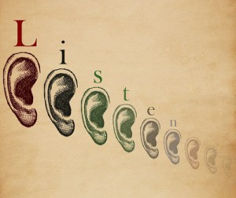
Characteristics of Listening
L = Look interested
I = Involve yourself by responding
S = Stay on target
T = Test your understanding
E = Evaluate the message
N = Neutralize your feelings

Slide 7
Listening Skills
Active listening
Listen with a purpose
Responding
Paraphrasing
Asking questions for clarification
Use non-verbal communication; smile, gestures, eye contact, and your posture
Give feedback

Slide 8
The Process of Listening can be categorized into 4 main areas
Hear
Clarify
Interpret
Respond

Slide 9
10 Steps to Effective Listening
Step 1: Face the speaker and maintain eye contact.
Step 2: Be attentive, but relaxed.
Step 3: Keep an open mind.
Step 4: Listen to the words and try to picture what the speaker is saying.
Step 5: Don’t interrupt and don’t impose your “solutions.”
Notes:
1 minute
Because the reality is that in engineering, effective communication will be crucial to your success. And that realization many engineers face as they begin their careers.
In fact, there is a saying that, “In engineering, you’ll only go as far as your communications skills will take you.”
And a recent survey conducted by ASME confirmed that. The respondents indicated that communications skills are crucial for success

Slide 10
10 Steps to Effective Listening (2)
Step 6: Wait for the speaker to pause to ask clarifying questions.
Step 7: Ask questions only to ensure understanding.
Step 8: Try to feel what the speaker is feeling.
Step 9: Give the speaker regular feedback.
Step 10: Pay attention to what isn’t said—to nonverbal cues.
Notes:
1 minute
Because the reality is that in engineering, effective communication will be crucial to your success. And that realization many engineers face as they begin their careers.
In fact, there is a saying that, “In engineering, you’ll only go as far as your communications skills will take you.”
And a recent survey conducted by ASME confirmed that. The respondents indicated that communications skills are crucial for success

Slide 11
Barriers to Effective Listening
Environmental
Judgemental Attitude
Bringing past at present
Habit of extra talking
Prediction and prejudices
Impatience and reaction mode
Selective listening
Personal Bias
Language/Culture Differences
Faking Attention

Slide 12
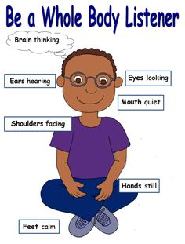

Slide 13
THANK YOU

